Slide 1
Clean Code
Refactoring Functions
April 2020

Slide 2
Small!
The ﬁrst rule of functions is that they should be small.
The second rule of functions is that they should be smaller than that.

Slide 3
Blocks and Indenting
This implies that the blocks within if statements, else statements, while statements, and so on should be one line long. Probably that line should be a function call.
This also implies that functions should not be large enough to hold nested structures.
Therefore, the indent level of a function should not be greater than one or two.

Slide 4
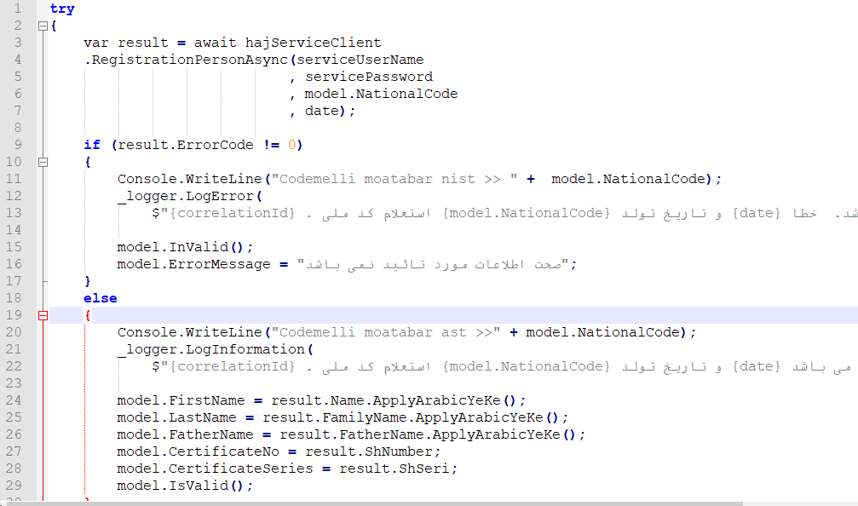

Slide 5
Do One Thing
FUNCTIONS SHOULD DO ONE THING. THEY SHOULD DO IT WELL. THEY SHOULD DO IT ONLY
The problem with this statement is that it is hard to know what “one thing” is.

Slide 6
One thing?!
If a function does only those steps that are one level below the stated name of the function, then the function is doing one thing. After all, the reason we write functions is to decompose a larger concept (in other words, the name of the function) into a set of steps at the next level of abstraction.
So, another way to know that a function is doing more than “one thing” is if you can extract another function from it with a name that is not merely a restatement of its implementation

Slide 7
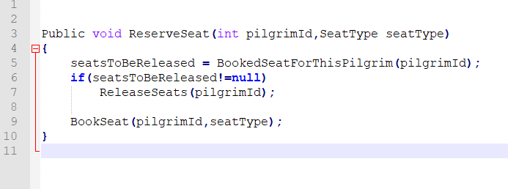
Example

Slide 8
One Level of Abstraction per Function
we need to make sure that the statements within our function are all at the same level of abstraction.
Mixing levels of abstraction within a function is always confusing. Readers may not be able to tell whether a particular expression is an essential concept or a detail. like broken windows, once details are mixed with essential concepts, more and more details tend to accrete within the function.

Slide 9
Reading Code from Top to Bottom: The Stepdown Rule
We want the code to read like a top-down narrative. We want every function to be followed by those at the next level of abstraction so that we can read the program, descending one level of abstraction at a time as we read down the list of functions. keeping the abstraction level consistent.

Slide 10
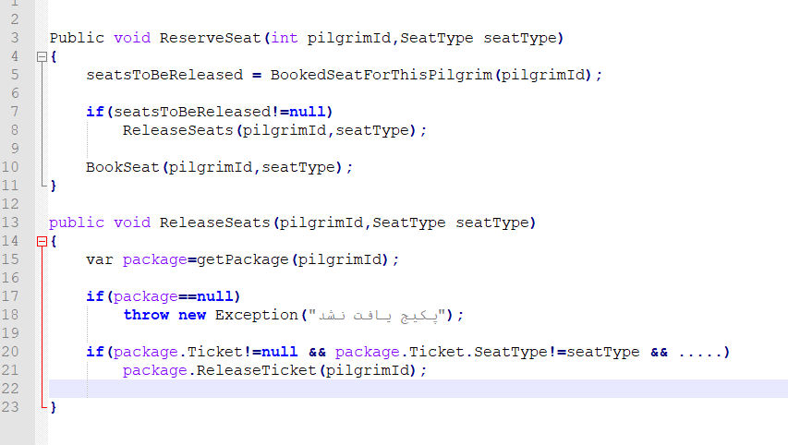

Slide 11
Switch Statements
It’s hard to make a small switch statement. Even a switch statement with only two cases is larger than I’d like a single block or function to be.
It’s also hard to make a switch statement that does one thing. By their nature,
Switch statements always do N things. Unfortunately we can’t always avoid switch statements, but we can make sure that each switch is buried in a low-level class and is never repeated. We do this, of course, with itch statement is polymorphism.

Slide 12
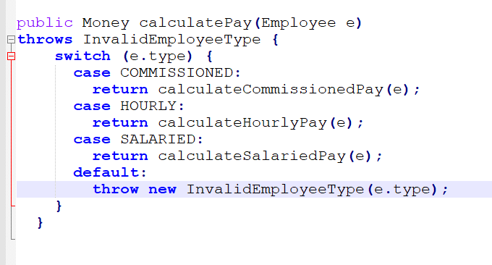
example

Slide 13
Problem?
There are several problems with this function. First, it’s large, and when new employee types are added, it will grow.
Second, it very clearly does more than one thing.
Third, it violates the Single Responsibility Principle
(SRP) because there is more than one reason for it to change. Fourth, it violates the Open Closed Principle (OCP) because it must change whenever new types are added.
The Open-Closed Principle (OCP) states that software entities (classes, modules, methods, etc.) should be open for extension, but closed for modification. In practice, this means creating software entities whose behavior can be changed without the need to edit and recompile the code itself.

Slide 14
Solution?!
One common way is to bury the switch statement in the basement of an ABSTRACT FACTORY, and never let anyone see it. The factory will use the switch statement to create appropriate instances of the derivatives of Employee, and the various functions, such as calculatePay, isPayday, and deliverPay, will be dispatched polymorphically through the Employee interface.
My general rule for switch statements is that they can be tolerated if they appear only once, are used to create polymorphic objects, and are hidden behind an inheritance

Slide 15
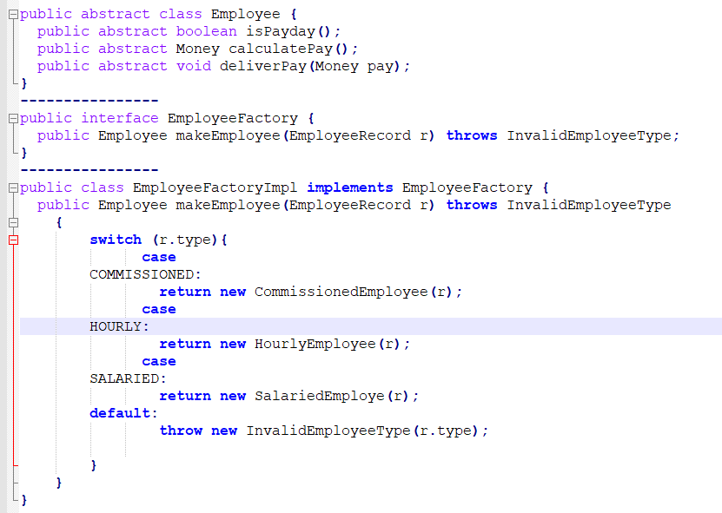

Slide 16
Use Descriptive Names
Don’t be afraid to make a name long. A long descriptive name is better than a short
A long descriptive name is better than a long descriptive comment

Slide 17
Function Arguments
The ideal number of arguments for a function is zero (niladic). Next comes one (monadic), followed closely by two (dyadic). Three arguments (triadic) should be avoided where possible. More than three (polyadic) requires very special justiﬁcation—and then shouldn’t be used anyway.
The argument is at a different level of abstraction than the function name and forces you to know a detail.
Arguments are even harder from a testing point of view. Imagine the difﬁculty of writing all the test cases to ensure that all the various combinations of arguments work properly.

Slide 18
Common Monadic Forms
There are two very common reasons to pass a single argument into a function.
You may be asking a question about that argument, as in
boolean fileExists(“MyFile”).
Or you may be operating on that argument, transforming it into something else and returning it.
InputStream fileOpen(“MyFile”)
If a function is going to transform its input argument, the transformation should appear as the return value.

Slide 19
Flag Arguments
Flag arguments are ugly. Passing a boolean into a function is a truly terrible practice. It immediately complicates the signature of the method, loudly proclaiming that this function does more than one thing. It does one thing if the ﬂag is true and another if the ﬂag is false!
We should have split the function into two

Slide 20
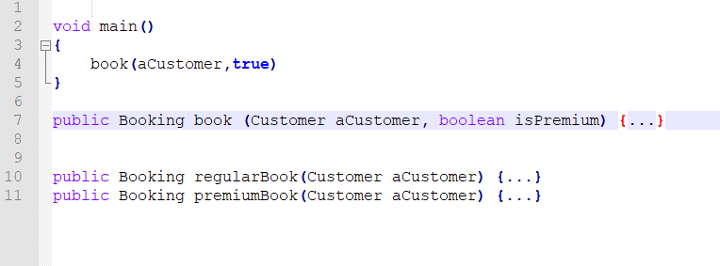
Example

Slide 21
Dyadic Functions
A function with two arguments is harder to understand than a monadic function.
For example, ReserveSeat (pilgrimId) is easier to understand than
ReserveSeat (package, pilgrimId).
There are times, of course, where two arguments are appropriate. For example, Point p = new Point(0,0); is perfectly reasonable. Indeed, we’d be very surprised to see new Point(0). However, the two arguments in this case are ordered components of a single value!
Whereas package and pilgrimId have neither a natural cohesion, nor a natural ordering.

Slide 22

Solution?!
For example, you might make the ReserveSeat method a member of Package so that you can say:
Or you might make the Package a member variable of the current class so that you don’t have to pass it.
Or you might extract a new class like Reserver that takes the package in its constructor and has a Reserve method.

Slide 23
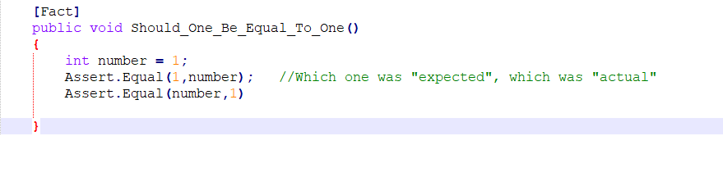
Even obvious dyadic functions like Assert.Equal (expected, actual) are problematic. How many times have you put the actual where the expected should be?
The two arguments have no natural ordering. The expected, actual ordering is a convention that requires practice to learn.

Slide 24

More than 2 arguments?
When a function seems to need more than two or three arguments, it is likely that some of those arguments ought to be wrapped into a class of their own.

Slide 25
Have No Side Effects
Your function promises to do one thing, but it also does other hidden things and that can lead to an unexpected result.

Slide 26
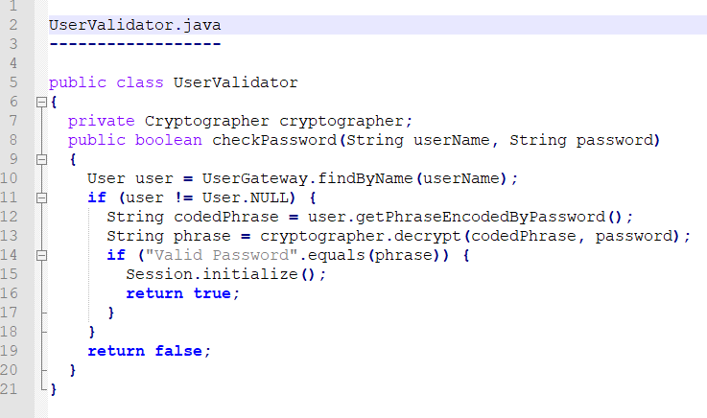
What is the “other thing” this function does?!
Notes:
The checkPassword function, by its name, says that it checks the password. The name does not imply that it initializes the session. So a caller who believes what the name of the function says runs the risk of erasing the existing session data when he or she decides to check the validity of the user.
This side effect creates a temporal coupling. That is, checkPassword can only be called at certain times (in other words, when it is safe to initialize the session). If it is called out of order, session data may be inadvertently lost. Temporal couplings are confusing, especially when hidden as a side effect. If you must have a temporal coupling, you should make it clear in the name of the function.
In this case we might rename the function checkPasswordAndInitializeSession, though that certainly violates “Do one thing.”

Slide 27
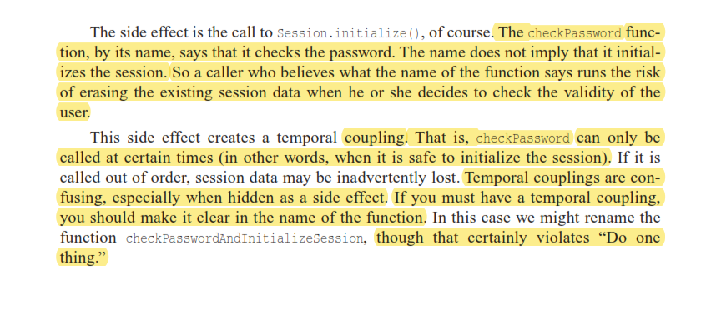

Slide 28
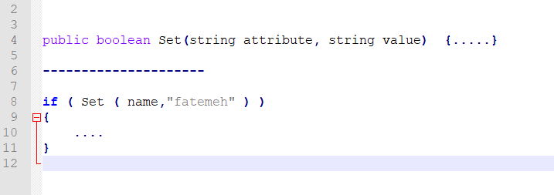
Command Query Separation
Functions should either do something or answer something, but not both.
Either your function should change the state of an object, or it should return some information about that object. Doing both often leads to confusion.

Slide 29
Prefer Exceptions to Returning Error Codes
Returning error codes from command functions is a subtle violation of command query separation. It promotes commands being used as expressions in the predicates of if statements.
if (deletePage(page) == E_OK)
This leads to deeply nested structures. When you return an error code, you create the problem that the caller must deal with the error immediately.

Slide 30
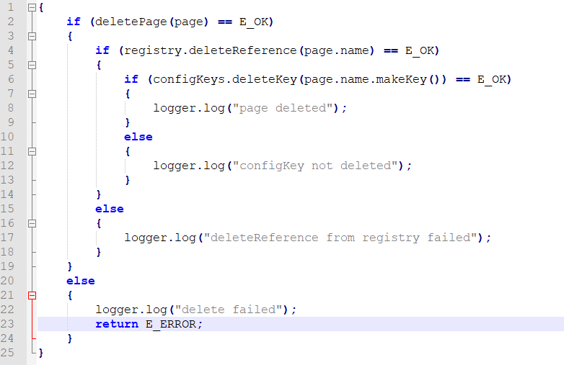

Slide 31
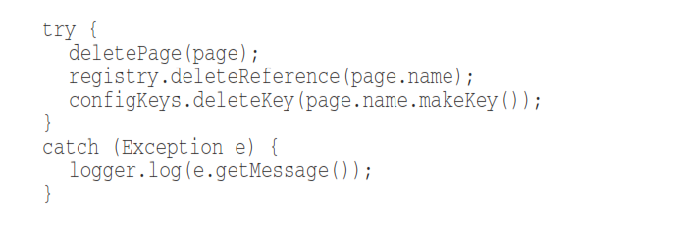
Solution?!
On the other hand, if you use exceptions instead of returned error codes, then the error processing code can be separated from the happy path code and can be simpliﬁed:

Slide 32
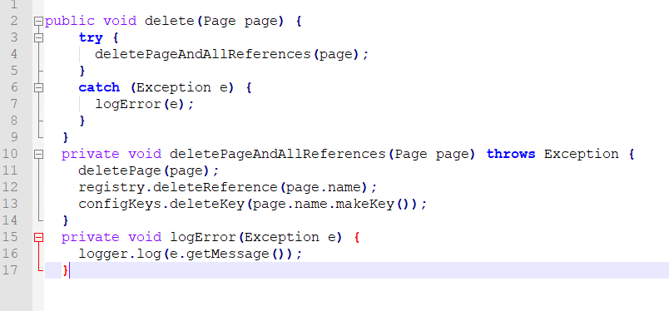
Try-Catch even better than that!
Try/catch blocks are ugly in their own right. They confuse the structure of the code and mix error processing with normal processing. So it is better to extract the bodies of the try and catch blocks out into functions of their own.

Slide 33
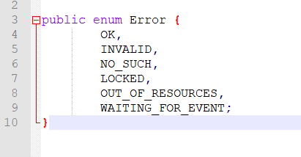
Error Code, good or bad?!
Returning error codes usually implies that there is some class or enum in which all the error codes are deﬁned.

Slide 34
Problem?
Classes like this are a dependency magnet; many other classes must import and use them. Thus, when the Error enum changes, all those other classes need to be recompiled and redeployed.

Slide 35
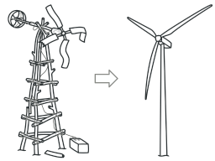
How Do You Write Functions Like This?!

Slide 36
How Do You Write Functions Like This?
When I write functions, they come out long and complicated.
They have lots of indenting and nested loops. They have long argument lists. The names are arbitrary, and there is duplicated code.
But I also have a suite of unit tests that cover every one of those clumsy lines of code.
So then I massage and reﬁne that code, splitting out functions, changing names, eliminating duplication. I shrink the methods and reorder them. Sometimes I break out whole classes, all the while keeping the tests passing.
In the end, I wind up with functions that follow the rules I’ve laid down in this chapter. I don’t write them that way to start. I don’t think anyone could.

Slide 37
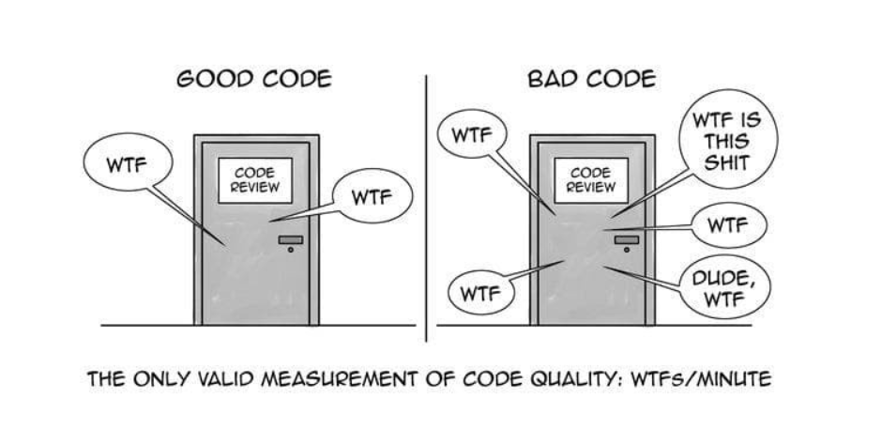
Finally,

Slide 38
Finally,
Master programmers think of systems as stories to be told rather than programs to be written.
They use the facilities of their chosen programming language to construct a much richer and more expressive language that can be used to tell that story.
Part of that domain-speciﬁc language is the hierarchy of functions that describe all the actions that take place within that system. In an artful act of recursion those actions are written to use the very domain-speciﬁc language they deﬁne to tell their own small part of the story.
Never forget that your real goal is to tell the story of the system, and that the functions you write need to ﬁt cleanly together into a clear and precise language to help you with that telling.

